Slide 1
CSE477
VLSI Digital Circuits
Fall 2002
Lecture 06: Static CMOS Logic
Mary Jane Irwin ( www.cse.psu.edu/~mji ) www.cse.psu.edu/~cg477
[Adapted from Rabaey’s Digital Integrated Circuits, ©2002, J. Rabaey et al.]
Notes:
Seating chart updates
Check web for copies of HW#2 (and lots of helpful hints) and for slides from previous lectures and for a tutorial on sue
Collect project proposals

Slide 2
Review: CMOS Process at a Glance
Define active areas
Etch and fill trenches
One full photolithography sequence per layer (mask)
Built (roughly) from the bottom up
  4 metal
  2 polysilicon
  3 source and drain diffusions
  1 tubs (aka wells, active areas)
Implant well regions
Deposit and pattern
polysilicon layer
exception!
Implant source and drain
regions and substrate contacts
Create contact and via windows
Deposit and pattern metal layers

Slide 3
CMOS Circuit Styles
Static complementary CMOS - except during switching, output connected to either V_{DD} or GND via a low-resistance path
  high noise margins
    full rail to rail swing
    V_{OH} and V_{OL} are at V_{DD} and GND, respectively
  low output impedance, high input impedance
  no steady state path between V_{DD} and GND (no static power consumption)
  delay a function of load capacitance and transistor resistance
  comparable rise and fall times (under the appropriate transistor sizing conditions)
Dynamic CMOS - relies on temporary storage of signal values on the capacitance of high-impedance circuit nodes
  simpler, faster gates
  increased sensitivity to noise
Notes:
Focus on combinational logic – output of the circuit is related to its current input signals by some Boolean expression
static CMOS - most widely used logic style

Slide 4
Static Complementary CMOS
Pull-up network (PUN) and pull-down network (PDN)
V_{DD}
PMOS transistors only
In₁
pull-up: make a connection from V_{DD} to F when F(In₁,In₂,…In_{N}) = 1
In₂
…
PUN
In_{N}
F(In₁,In₂,…In_{N})
In₁
pull-down: make a connection from F to GND when F(In₁,In₂,…In_{N}) = 0
In₂
…
PDN
In_{N}
NMOS transistors only
PUN and PDN are dual logic networks
Notes:
One and only one of the networks (PUN or PDN) is conducting in steady state (output node is always a low-impedance node in steady state)
Why PUN of PMOSs only and PDN of NMOSs only ? (Next slide)

Slide 5
Threshold Drops
V_{DD}
V_{DD}
PUN
V_{DD}
0 →
0 →
C_{L}
C_{L}
PDN
V_{DD} →
V_{DD} →
C_{L}
C_{L}
V_{DD}
Notes:
For class handout

Slide 6
Threshold Drops
V_{DD}
V_{DD}
PUN
S
D
V_{DD}
D
0 → V_{DD}
S
0 → V_{DD} - V_{Tn}
V_{GS}
C_{L}
C_{L}
PDN
V_{DD} → 0
V_{DD} → |V_{Tp}|
V_{GS}
D
C_{L}
S
C_{L}
V_{DD}
S
D
Notes:
Why PMOS in PUN and NMOS in PDN … threshold drop
NMOS transistors produce strong zeros; PMOS transistors generate strong ones
Two circuits on the right cut-off before the ideal voltage level is reached (when VGS < VT)
Ask to think about two nfets in series, both with Vdd gates and a Vdd on the drain “input” – how many voltage drops?
Ask to think about two nfets, the output of the first driving the gate of the second, both the Vdd drain “inputs” – how many voltage drops?

Slide 7
Construction of PDN
NMOS devices in series implement a NAND function
NMOS devices in parallel implement a NOR function
A • B
A
B
A + B
A
B

Slide 8
Dual PUN and PDN
PUN and PDN are dual networks
  DeMorgan’s theorems
    A + B = A • B [!(A + B) = !A • !B or !(A | B) = !A & !B]
    A • B = A + B [!(A • B) = !A + !B or !(A & B) = !A | !B]
  a parallel connection of transistors in the PUN corresponds to a series connection of the PDN
Complementary gate is naturally inverting (NAND, NOR, AOI, OAI)
Number of transistors for an N-input logic gate is 2N

Slide 9
CMOS NAND
A | B | F
0 | 0 | 1
0 | 1 | 1
1 | 0 | 1
1 | 1 | 0
A
B
A • B
A
B
A
B

Slide 10
CMOS NOR
A | B | F
0 | 0 | 1
0 | 1 | 0
1 | 0 | 0
1 | 1 | 0
B
A
A + B
A
B
A
B

Slide 11
Complex CMOS Gate
OUT = !(D + A • (B + C))
A
D
B
C
Notes:
For class handout

Slide 12
Complex CMOS Gate
B
A
C
D
OUT = !(D + A • (B + C))
A
D
B
C
Notes:
Shown synthesis of pull up from pull down structure
Max of 3 transistors in series (in the PUN)

Slide 13
Standard Cell Layout Methodology
Routing
channel
V_{DD}
signals
GND
What logic function is this?
Notes:
Route VDD and GND horizontally
Route singals in poly perpendicular to VDD and GND (vertically) – poly can serve as input to both nfets and pfets
Order inputs (consistent Euler path) to optimize the horizontal connectivity of diff strips
want unbroken row of devices with abutting source/drain connections – so there is only one strip of diffusion in both wells
3) Place diffs in horizontal strips
4) Interconnect appropriately
Interconnect between cells are done in “routing channels”
Contacts and wells not shown.
What does this implement?? (NAND feeding an Inverter – so an AND)

Slide 14
OAI21 Logic Graph
X
PUN
A
j
C
B
C
X
i
V_{DD}
X = !(C • (A + B))
C
i
B
j
A
A
B
PDN
A
GND
B
C
Notes:
Systematic approach to derive order of input signal wires so gate can be laid out to minimize area
Note PUN and PDN are duals (parallel <-> series)
Vertices are nodes (signals) of circuit, VDD, X, GND and edges are transitions

Slide 15
Two Stick Layouts of !(C • (A + B))
A
C
B
A
B
C
V_{DD}
V_{DD}
X
X
GND
GND
uninterrupted diffusion strip
Notes:
Line of diffusion layout – abutting source-drain connections
Note crossover of left layout eliminated by A B C ordering – talk about area needed for via (and speed impact due to via resistance)

Slide 16
Consistent Euler Path
An uninterrupted diffusion strip is possible only if there exists a Euler path in the logic graph
  Euler path: a path through all nodes in the graph such that each edge is visited once and only once.
X
C
X
i
V_{DD}
B
j
A
GND
For a single poly strip for every input signal, the Euler paths in the PUN and PDN must be consistent (the same)

Slide 17
Consistent Euler Path
An uninterrupted diffusion strip is possible only if there exists a Euler path in the logic graph
  Euler path: a path through all nodes in the graph such that each edge is visited once and only once.
X
C
X
i
V_{DD}
B
j
A
GND
A
B
C
For a single poly strip for every input signal, the Euler paths in the PUN and PDN must be consistent (the same)
Notes:
A path through all nodes in the graph such that each edge is visited once and only once.
The sequence of signals on the path is the signal ordering for the inputs.
PUN and PDN Euler paths are (must be) consistent (same sequence)
If you can define a Euler path then you can generate a layout with no diffusion breaks
A B C
C A B
B C A → no PDN -> show how with ppt pen drawing
B A C
A C B -> no PDN
C B A

Slide 18
OAI22 Logic Graph
X
PUN
A
C
B
D
D
C
X
V_{DD}
X = !((A+B)•(C+D))
C
D
B
A
A
B
PDN
A
GND
B
C
D
Notes:
Consistent Euler paths
ABDC
BDCA
DCAB
CABD
BACD
ACDB
CDBA
DBAC
and NOT DACB, BCAD, etc.

Slide 19
OAI22 Layout
A
B
D
C
V_{DD}
X
GND
Some functions have no consistent Euler path like x = !(a + bc + de) (but x = !(bc + a + de) does!)
Notes:
Can you draw the Euler diagrams for both and show the consistent Euler path(s) for the second?

Slide 20
XNOR/XOR Implementation
XNOR
XOR
A
A
A ⊕ B
B
B
A ⊕ B
A
A
B
B
A ⊕ B
A ⊕ B
How many transistors in each?
Can you create the stick transistor layout for the lower left circuit?
Notes:
12 and 10 transistor implementations of static XOR circuit

Slide 21
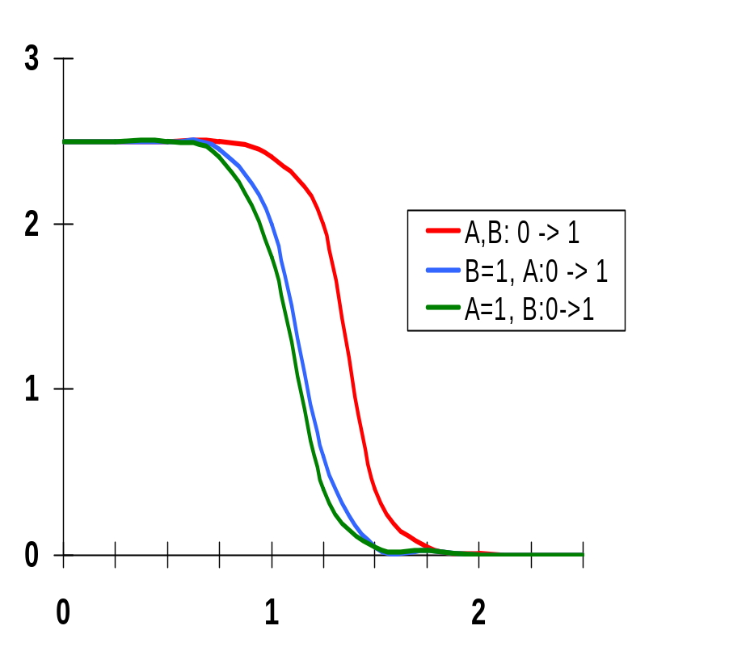
VTC is Data-Dependent
0.5μ/0.25μ NMOS
0.75μ /0.25μ PMOS
A
M₃
B
M₄
F= A • B
D
weaker
PUN
A
M₂
S
V_{GS2} = V_{A} –V_{DS1}
D
Cint
B
M₁
V_{GS1} = V_{B}
S
The threshold voltage of M₂ is higher than M₁ due to the body effect (γ)
V_{Tn1} = V_{Tn0}
V_{Tn2} = V_{Tn0} + γ(√(|2φ_{F}| + V_{int}) - √|2φ_{F}|)
since V_{SB} of M₂ is not zero (when V_{B} = 0) due to the presence of Cint
Notes:
VTC characteristics are dependent upon the data input patterns applied to the gate (so the noise margins are also data dependent!)
Threshold voltage of M2 will be higher than transistor M1 due to body effect
Case 1 – both transistors in the PUN are on simultaneously for A=B=0, representing a strong pull-up. In the other two cases only one of the pull-up devices is on. So the VTC is shifted left as a result of the weaker PUN for the second and third cases.
Case 2 – see Case 3, small difference can be attributed to the body effect of M2 and the drive voltage
Case 3 – M2 as resistor in series with M1, so only small effect on VTC; since pulldown is strong and pullup weaker than case 1, VTC shifted to the left
(also have to discharge both CL (on the output) and Cint (possibly) thru M1 so will also be slower!)

Slide 22
Static CMOS Full Adder Circuit
B
A
B
B
A
B
C_{in}
A
A
C_{in}
!C_{out}
!Sum
C_{in}
A
C_{in}
A
A
B
B
A
B
C_{in}
B
Notes:
24 + 4 (for C and Sum inverter) transistor Full Adder
No more than 3 transistors in series
Loads: A-8, B-8, Cin-6, !Cout-2
Number of “gate delays” to Sum – 3?

Slide 23
Static CMOS Full Adder Circuit
!C_{out} = !C_{in} & (!A | !B) | (!A & !B)
!Sum = C_{out} & (!A | !B | !C_{in}) | (!A & !B & !C_{in})
B
A
B
B
A
B
C_{in}
A
A
C_{in}
!C_{out}
!Sum
C_{in}
A
C_{in}
A
A
B
B
A
B
C_{in}
B
C_{out} = C_{in} & (A | B) | (A & B)
Sum = !C_{out} & (A | B | C_{in}) | (A & B & C_{in})
Notes:
24 + 4 (for C and Sum inverter) transistor Full Adder
No more than 3 transistors in series
Loads: A-8, B-8, Cin-6, !Cout-2
Number of “gate delays” to Sum – 3?

Slide 24
Next Time: Pass Transistor Circuits
A
A ⊕ B
B
Notes:
6 transistor implementation of XOR
Figure out how it works and why for next lecture

Slide 25
Next Lecture and Reminders
Next lecture
  Pass transistor logic
    Reading assignment – Rabaey, et al, 6.2.3
Reminders
  Project Title due today !
  Lecture 5 will be next Thursday (guest lecturer)
  HW2 due September 24th
  Evening midterm exam scheduled
    Wednesday, October 10th from 8:15 to 10:15pm in 260 Willard
    Only one midterm conflict filed for so far

